Slide 1
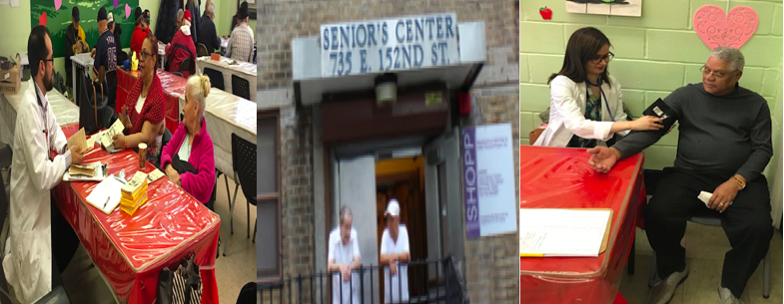
Leon Senior Center

Slide 2
Community Assessment: Windshield Assessment
What significant enclaves or discrete populations are represented?
According to US census 2010, the total population of Mot haven (Zip code: 10455) is 39,665.
Ethnic Group
Subject | Total | Percent (%)
Population | 39,665 | 100.0
Hispanic or Latino (of any race) | 29,676 | 74.8
Mexican | 3,821 | 9.6
Puerto Rican | 13,020 | 32.8
Cuban | 192 | 0.5
Other Hispanic or Latino | 12,643 | 31.9
Not Hispanic or Latino | 9,989 | 25.2
Source: https://factfinder.census.gov/faces/tableservices/jsf/pages/productview.xhtml?src=CF

Slide 3
Community Assessment: Windshield Assessment Continued …
According to Us Census Bureau (2010), the population representation is as below;
Age (group) | Total Population | Male | Female | Total Percent (100)
Under 18 years | 11,880 | 6,067 | 5,813 | 30.0
18 to 64 years | 24,307 | 11,361 | 12,946 | 61.3
65 years and over | 3,478 | 1,351 | 2,127 | 8.8
18 to 24 years | 4,887 | 2,509 | 2,378 | 12.3
25 to 44 years | 11,427 | 5,279 | 6,148 | 28.8
25 to 34 years | 6,156 | 2,826 | 3,330 | 15.5
35 to 44 years | 5,271 | 2,453 | 2,818 | 13.3
45 to 64 years | 7,993 | 3,573 | 4,420 | 20.2
45 to 54 years | 4,807 | 2,157 | 2,650 | 12.1
55 to 64 years | 3,186 | 1,416 | 1,770 | 8.0
65 to 74 years | 2,100 | 867 | 1,233 | 5.3
75 to 84 years | 1,087 | 398 | 689 | 2.7
85 years and over | 291 | 86 | 205 | 0.7
Source: https://factfinder.census.gov/faces/tableservices/jsf/pages/productview.xhtml?src=CF

Slide 4
Community Assessment: Windshield Assessment Continued …
Estimated population as of 2016 by US Census Bureau is as follows:
Subject | Estimate | Margin of error
Population (42,779) | 7.7% | +/-1,648
AGE
Under 5 years | 9.3% | +/-0.9
5 to 9 years | 8.2% | +/-0.8
10 to 14 years | 7.4% | +/-0.8
15 to 19 years | 7.0% | +/-0.9
20 to 24 years | 8.1% | +/-0.9
25 to 29 years | 9.0% | +/-1.1
30 to 34 years | 8.3% | +/-1.1
35 to 39 years | 7.0% | +/-1.0
40 to 44 years | 5.3% | +/-0.9
45 to 49 years | 5.7% | +/-0.9
50 to 54 years | 6.4% | +/-0.9
55 to 59 years | 5.2% | +/-0.8
60 to 64 years | 4.3% | +/-1.3
65 to 69 years | 2.9% | +/-0.5
70 to 74 years | 2.6% | +/-0.5
75 to 79 years | 1.5% | +/-0.4
80 to 84 years | 1.0% | +/-0.3
85 years and over | 0.8% | +/-0.3
https://factfinder.census.gov/faces/tableservices/jsf/pages/productview.xhtml?src=CF

Slide 5
Community Assessment: Windshield Assessment Continued …
Religious organization or churches near Leon Senior Centre
Bethel Way Cross Address: Po Box 229 Bronx, NY 10455-0229
Greater Victory Baptist Church Address: Po Box 303 Bronx, NY 10455-0303
Second Christian Church Lamb Of Zion Address: Po Box 909 Bronx, NY 10455-0909
Browns Union Ame Church Address: 384 E 155th St, Bronx, NY 10455-1104
St Adalbert Church Address: 420 E 156th St, Bronx, NY 10455-1232
New Jerusalem Pentecostal A/g Address: 671 E 156th St, Bronx, NY 10455-1505

Slide 6
Community Assessment: Windshield Assessment Continued …
Religious organization or churches near Leon Senior Centre
Mott Haven Sda Church Address: 600 Westchester Ave, Bronx, NY 10455-1521
Bronx Spanish Evang Church Address: 796 E 156th St, Bronx, NY 10455-1729
Philadelphia Christian Church Address: 860 E 156th St, Bronx, NY 10455-1802
Transfiguration Lutheran Church Address: 763 Prospect Ave, Bronx, NY10455-1809
United Church Address: 764 Hewitt Pl Bronx, NY 10455-1810
Christian Church Of The Valley Address: 843 E 156th St, Bronx, NY 10455-1814

Slide 7
Community Assessment: Windshield Assessment Continued …
Schools near by Leon Senior Centre
University Heights High School. 701 St Ann's Ave, Bronx, NY 10455
Jm Rapport School For Career Development. 470 Jackson Ave, Bronx, NY 10455
P.S. 25 Bilingual School. 811 E 149th St, Bronx, NY 10455
Mott Haven Community High School. 455 Southern Blvd, Bronx, NY 10455
Hostos-Lincoln Academy of Science. 600 St Ann's Ave, Bronx, NY 10455
Public School 277. 519 St Ann's Ave, Bronx, NY 10455
University Prep Schools. 600 St Ann's Ave, Bronx, NY 10455
P.S. 130 Abram Steven Hewitt School.

Slide 8
Community Assessment: Windshield Assessment Continued …
Health facilities near by Leon Senior Centre
Geel Community Services Inc. 706 Union Ave, Bronx, NY 10455
South Bronx Children Health Center. 871 Prospect Ave, Bronx, NY 10459
Renaissance Home Health Care Services – Bronx. 787 E 156th St #201, Bronx, NY 10455
Global Medical. 814 E 156th St, Bronx, NY 10455
Ramon Velez Health Center. 754 E 151st St, Bronx, NY 10455
Dr Emily Women's Health Center. 642 Southern Blvd, Bronx, NY 10455

Slide 9
Community Assessment: Windshield Assessment Continued …
Social Agencies near by Leon Senior Centre
BronxWorks Betances Community Center. 547 E 146th St, Bronx, NY 10455
Catholic Charities Community Services. 402 E 152nd St, Bronx, NY 10455
Episcopal Social Services. 500 Bergen Ave, Bronx, NY 10455
BronxWorks. 630 Southern Blvd, Bronx, NY 10455
Osborne Association. 809 Westchester Ave, Bronx, NY 10455
Catholic Charities Community Services. 402 E 152nd St, Bronx, NY 10455

Slide 10
Community Assessment: Windshield Assessment Continued …
Noticeable Health Hazards
Potholes: There are many potholes present in the streets; mainly in Westchester Avenue
Busy streets: Southern Blvd, Westchester Avenue
Erased street dividing markers
Lack of Traffic Lights: Some street intersections has no traffic Light and only with stop signs .
Pile of trash covering fire Hydrants and Sidewalks.

Slide 11
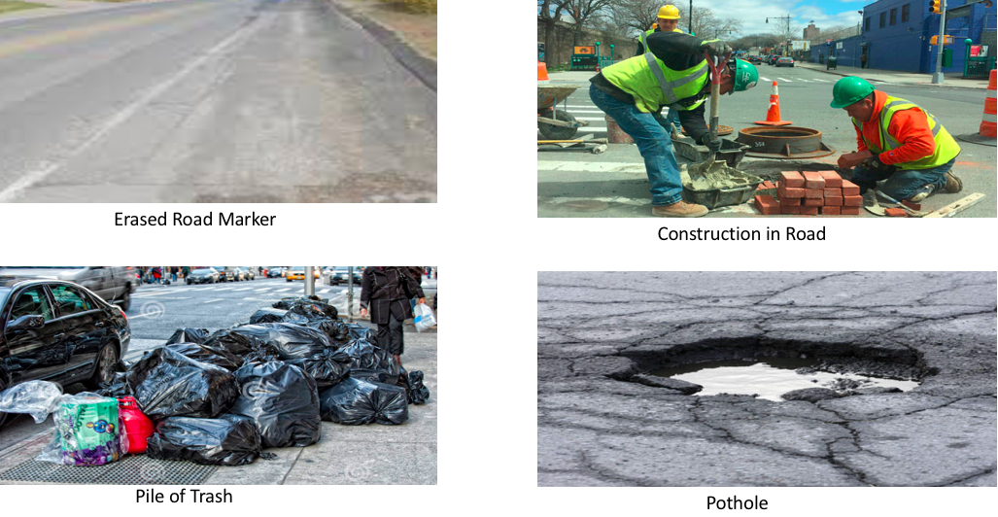
Community Assessment: Windshield Assessment Continued …

Slide 12
Domain 3 significance
It helps to ensure coordination of care for both services under one roof.
Helps identify behavioral health diagnosis early allowing rapid treatment
It integrates depression treatment into primary care and improves physical and social functioning, while cutting the overall cost of providing care
Implementation of evidence based medication adherence programs (MAP) in community based sites for behavioral health medication compliance assist patients identify these issues and resolve them with motivational interviewing and structured conversations around medication compliance.
3.a.iv Development of Withdrawal Management (e.g., ambulatory detoxification, ancillary withdrawal services) capabilities and appropriate enhanced abstinence services within community-based addiction treatment programs will provide patient with care management services that will assist the stabilizing patient to organize medical, educational, legal, financial, social, family and childcare services in support of abstinence and improved function within the community.

Slide 13
Domain 3 significance continued…
Behavioral Interventions Paradigm (BIP) in Nursing Homes program provides a pathway to avoid transfers to hospitals and to ensure better care for the SNF patient with behavioral issues.
Evidence-based strategies for disease management in high risk/affected populations ensure clinical practices in the community and ambulatory care setting, use evidence based strategies to improve management of cardiovascular disease, Diabetes and Asthma.
Comprehensive Strategy to decrease HIV/AIDS transmission to reduce avoidable hospitalizations – development of a Center of Excellence for Management of HIV/AIDS are effective strategies to manage viral loads of HIV, slow progression of the disease and reduce transmission.
Increasing access to palliative care programs for persons with serious illnesses and those at end of life can help ensure care and end of life planning needs are understood, addressed and met prior to decisions to seek further aggressive care or enter hospice.

Slide 14
Domain 4 significance
In addition to evidence substance abuse and other MEB disorders can be prevented, there is confirmation that early identification and adequate societal support can prevent and alleviate serious consequences such as death, poor functioning and chronic illness.
Although there have been substantial reductions in adult smoking in NYS, some tobacco use disparities have become more pronounced over the past decade. Smoking rates did not decline among low-socioeconomic status adults and adults with poor mental health. Promote tobacco use cessation, especially among low SES populations and those with poor mental health project will help decrease smoking rates among low-socioeconomic status adult and adult with poor mental health.
Delivery of high-quality chronic disease preventive care and management can prevent much of the burden of chronic disease or avoid many related complications.
There is increase in early access to, and retention in, HIV care.
4.c.iii Decrease STD morbidity

Slide 15
Role as a RN to BSN student
As an RN to BSN student in Lehman college, I got an opportunity to work with the seniors in Leon senior center under Neighborhood shop.
This was a unique experience for me as I was making brochoures every week in Nepali language.
I strongly believe that I maintained professionalism through my personal behaviors and appearance. Just as I would maintain client confidentiality in a hospital, I maintained it in Leon senior centre
Being a registered nurse and knowing how to communicate effectively allowed some of the seniors to trust me.
While doing blood pressure I got to know some of the the herbs seniors were using to lower their blood pressure, for example one of the senior was drinking turmeric and ginger mixed with boiled water every day to decrease her blood pressure which used to be high at one point of her life.

Slide 16
Role as a RN to BSN student continued….
Overall, The environment at the center was welcoming and I felt that it was a good learning experience. It gave me the opportunity to grow as a Registered Nurse. Working in Leon senior center made me realize that nursing is such a diverse path and nurses do not only have to stay at the bed-side in hospitals or clinics. Nurses can take their work outside to communities that could really use their help. I love the versatility within nursing. As I continue my education in nursing, I know that I will continue to grow. I love learning about new things, especially when it comes to nursing.

Slide 17
Reference:
Community Facts - Find popular facts and frequently requested data about your community
https://factfinder.census.gov/faces/tableservices/jsf/pages/productview.xhtml?src=CF
Department of Health. (n.d.). Retrieved April 26, 2018, from
https://www.health.ny.gov/health_care/medicaid/redesign/dsrip/2016/d4guidance_2015-06-08_final.htm#introc
New York State Delivery System Reform Incentive Payment Program Project Toolkit. (n.d.). Retrieved April 26, 2018, from
https://www.health.ny.gov/health_care/medicaid/redesign/docs/dsrip_project_toolkit.pdf

